Slide 1
MOVIE DATA ANALYSIS USING HADOOP,HIVE AND SQOOP
PROJECT-01 Nirosha.M

Slide 2
OBJECTIVE
Use Sqoop to collect data and to store the data to HDFS. Process various insights while analyzing the data using Hive. The database consist of movies_dataset table, I will import movies_dataset table, which contains about movies id, names, year, rating and duration.
In this project I collect the movies dataset from Data World.
Movie dataset contains 49590 rows and five columns.
Tool
Hortonworks Sandbox
Ambari

Slide 3
to create directory in hdfs
Command:
hdfs dfs -mkdir '/moviedata/’
After creating a directory in hdfs then enter into the hive using the hive command

Slide 4
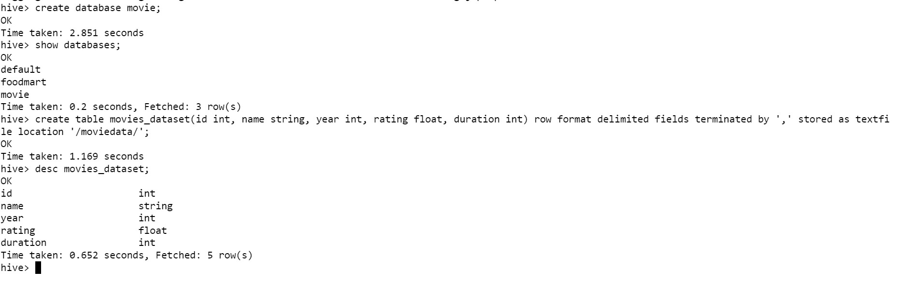
To Create database and table in hive
After creating a table stored .txt movies data file into the sub directory ‘movies_dataset’ using the Ambari Interface

Slide 5
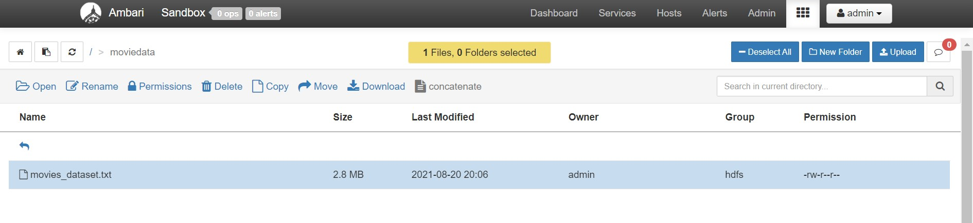
Data loading through ambari

Slide 6
Problem statements
Find the total number of movies in the dataset.
Find the number of movies released between 1950 and 1960.
Find the number of movies having rating more than 4.
Find the number of movies with duration more than 2 hours (7200 second).
Find the movies whose rating are between 3 and 4.
Find the list of years and number of movies released each year.
Find the movies whose name 'Shinobi Girl’.
Find the number of movies start with win.
Group by clause.
Find the maximum year.

Slide 7
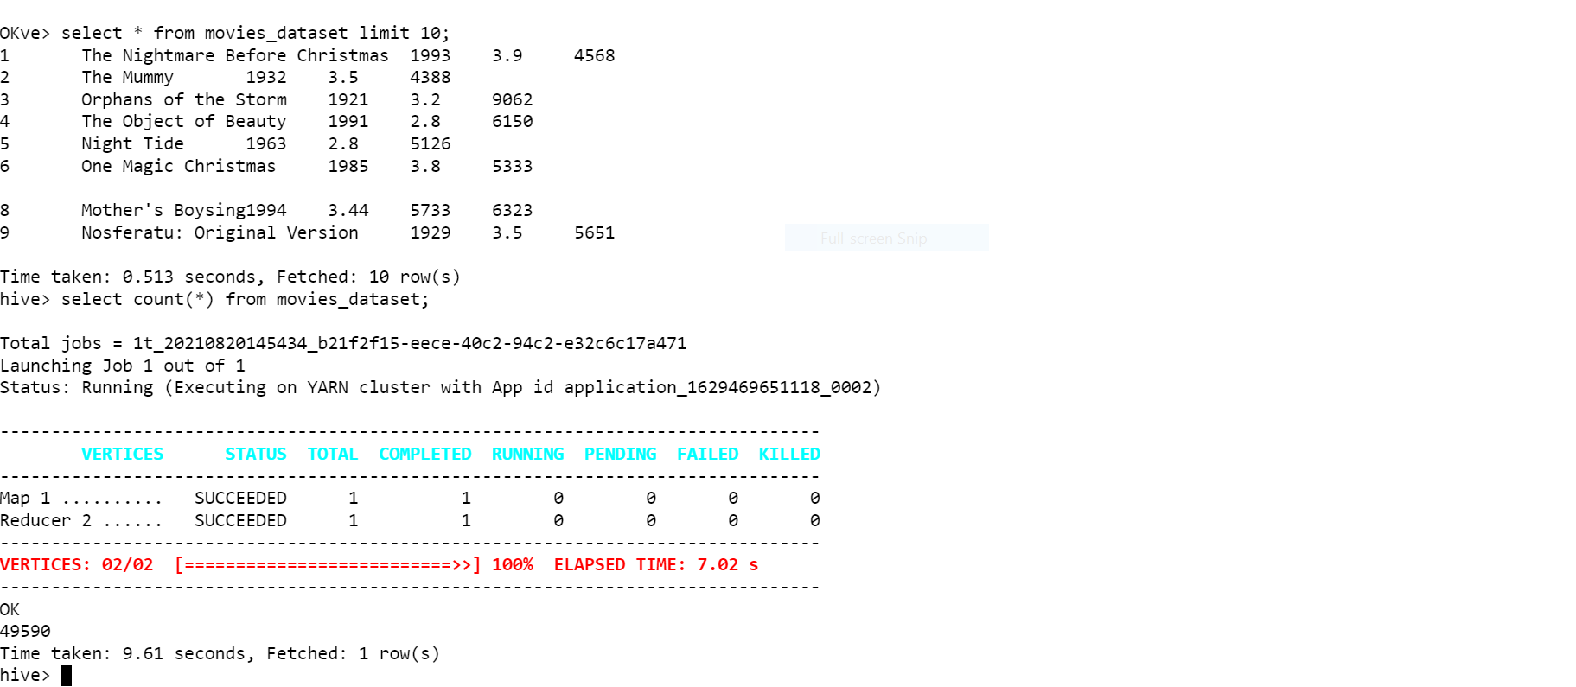
1)Command:
select count(*) from movies_dataset;

Slide 8
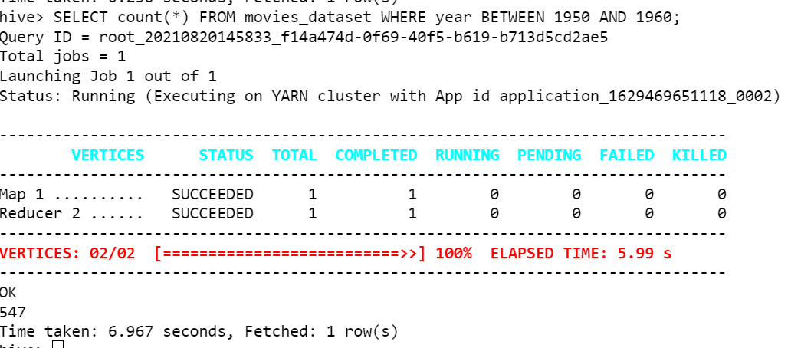
2)Command:
SELECT count(*) FROM movies_dataset WHERE year BETWEEN 1950 AND 1960;

Slide 9
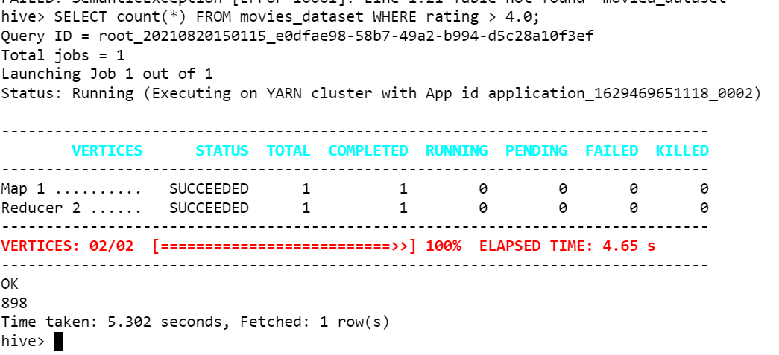
3) Command:
SELECT count(*) FROM movies_dataset WHERE rating > 4.0;

Slide 10
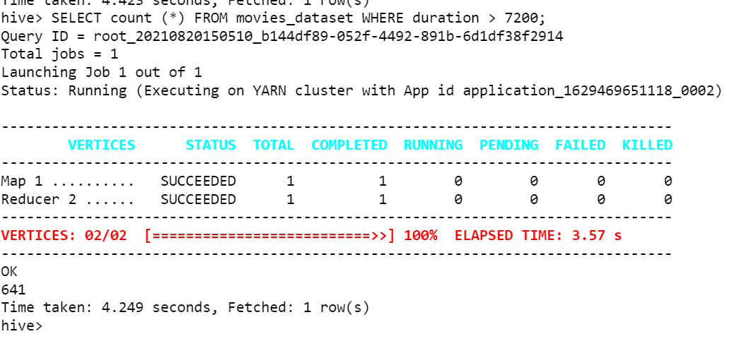
4)Command:
SELECT count (*) FROM movies_dataset WHERE duration > 7200;

Slide 11
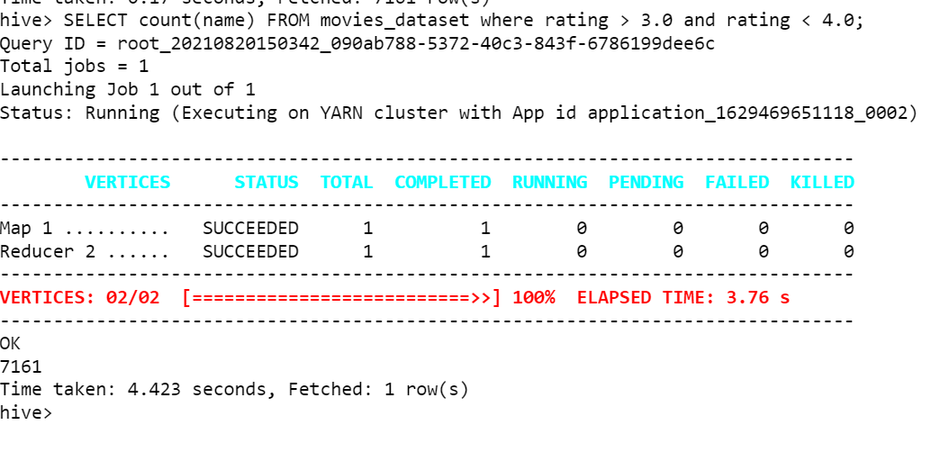
5)Command:
SELECT count(name) FROM movies_dataset where rating > 3.0 and rating < 4.0;

Slide 12
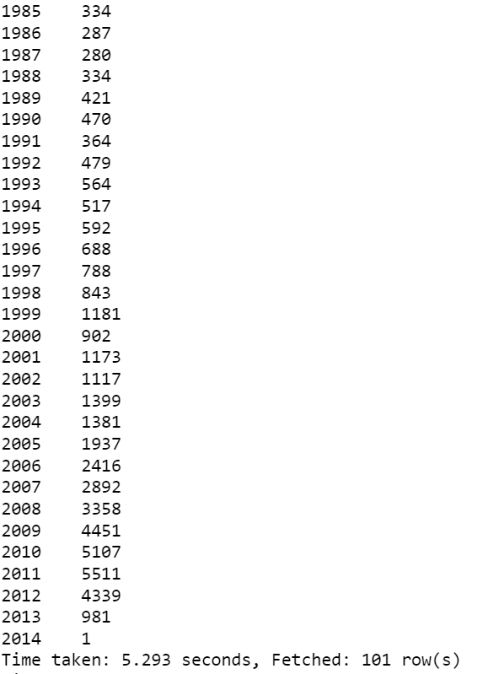
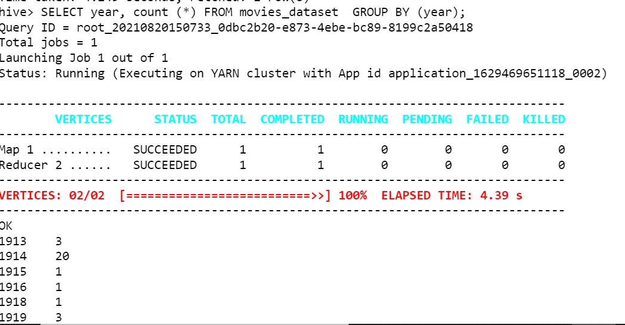
6)Command:
SELECT year, count (*) FROM movies_dataset GROUP BY (year);

Slide 13
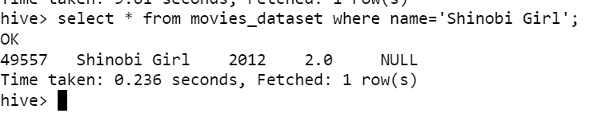
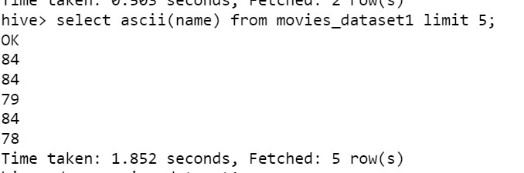
7)Command:
select * from movies_dataset where name='Shinobi Girl';
Ascii Function

Slide 14
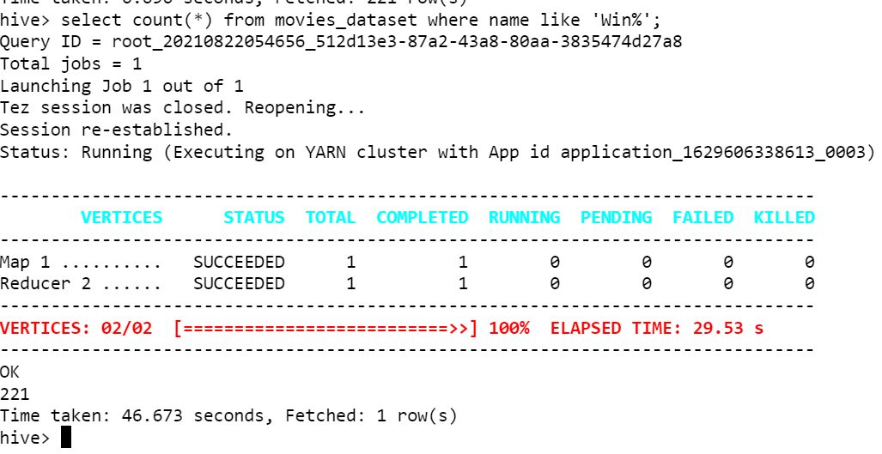
8)Command:
select count(*) from movies_dataset where name like 'Win%';

Slide 15
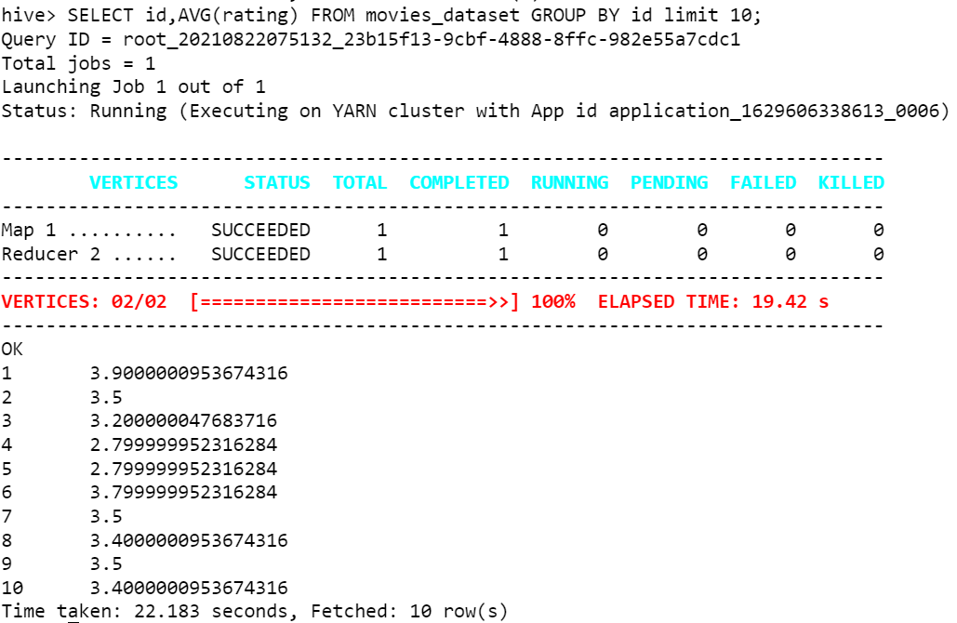
9)Command:
SELECT id,AVG(rating) FROM movies_dataset GROUP BY id limit 10;

Slide 16
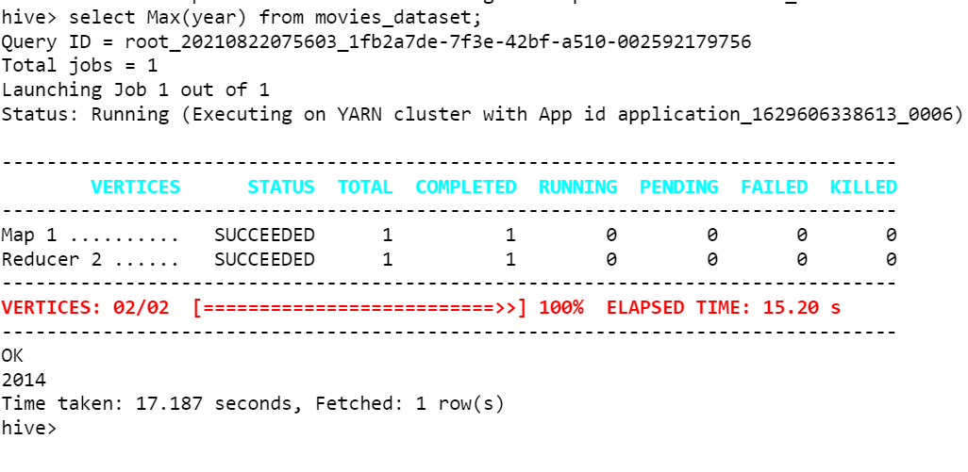
10) Command:
select Max(year) from movies_dataset;

Slide 17
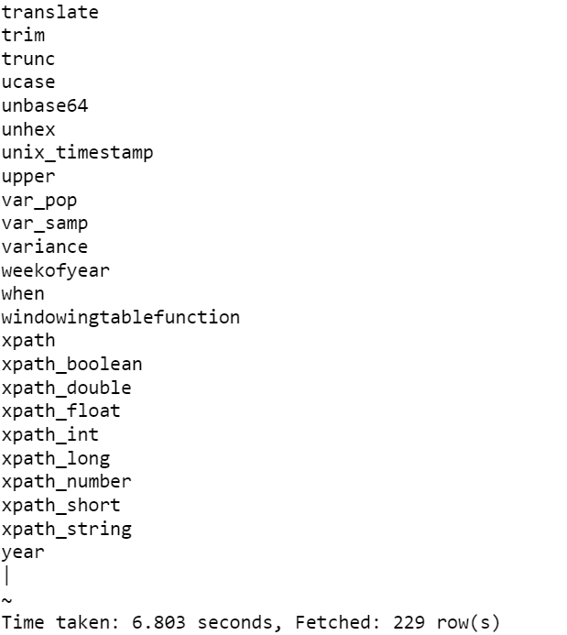
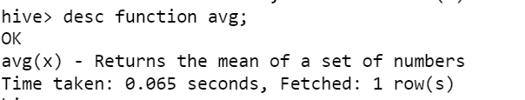
Functions
Command:
show functions;
desc function avg;

Slide 18
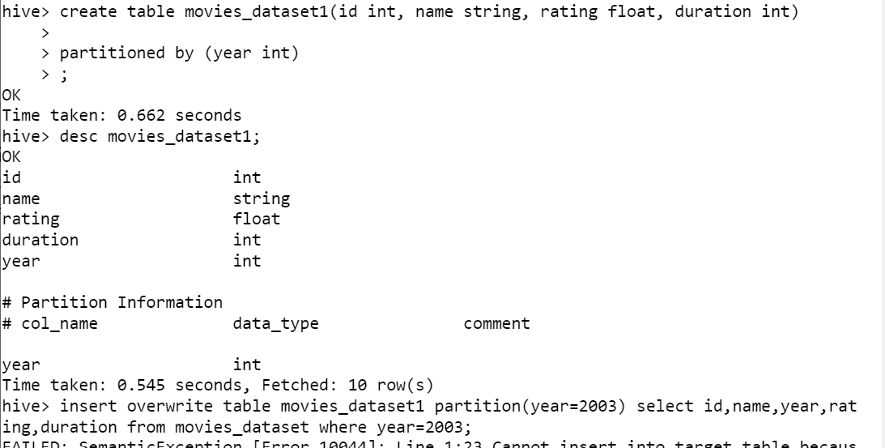
Partioning based on column
create table movies_dataset1(id int, name string, rating float, duration int) partitioned by (year int);
desc movies_dataset1;
insert overwrite table movies_dataset1 partition(year='2003') select id,name,year,rating,duration from movies_dataset where year='2003’;
select * from movies_dataset1;

Slide 19
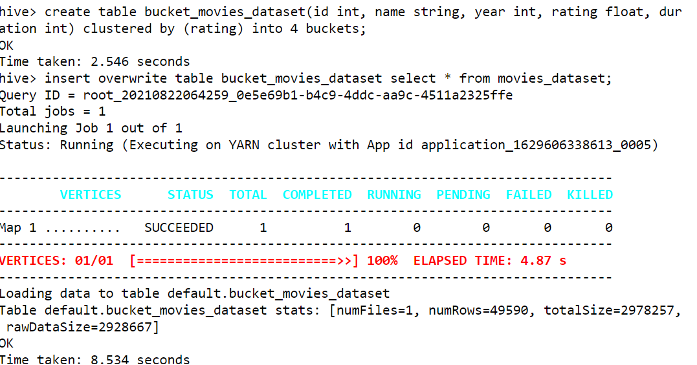
Bucketing
Commands:
create table bucket_movies_dataset(id int, name string, year int, rating float, duration int) clustered by (rating) into 4 buckets;
insert overwrite table bucket_movies_dataset select * from movies_dataset;

Slide 20
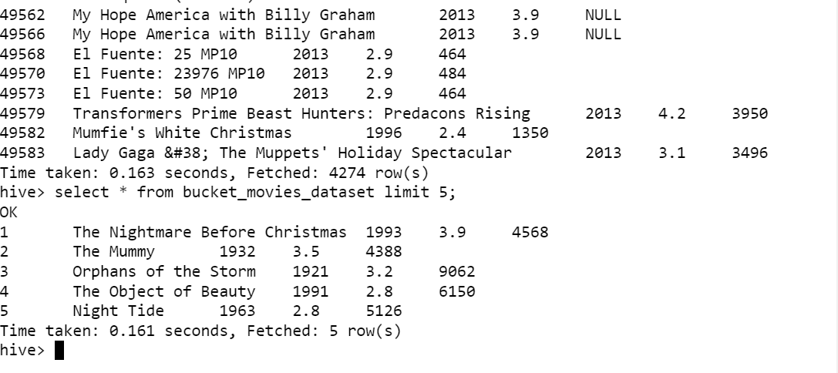
select * from bucket_movies_dataset tablesample(bucket 3 out of 4 on rating);
select * from bucket_movies_dataset limit 5;

Slide 21
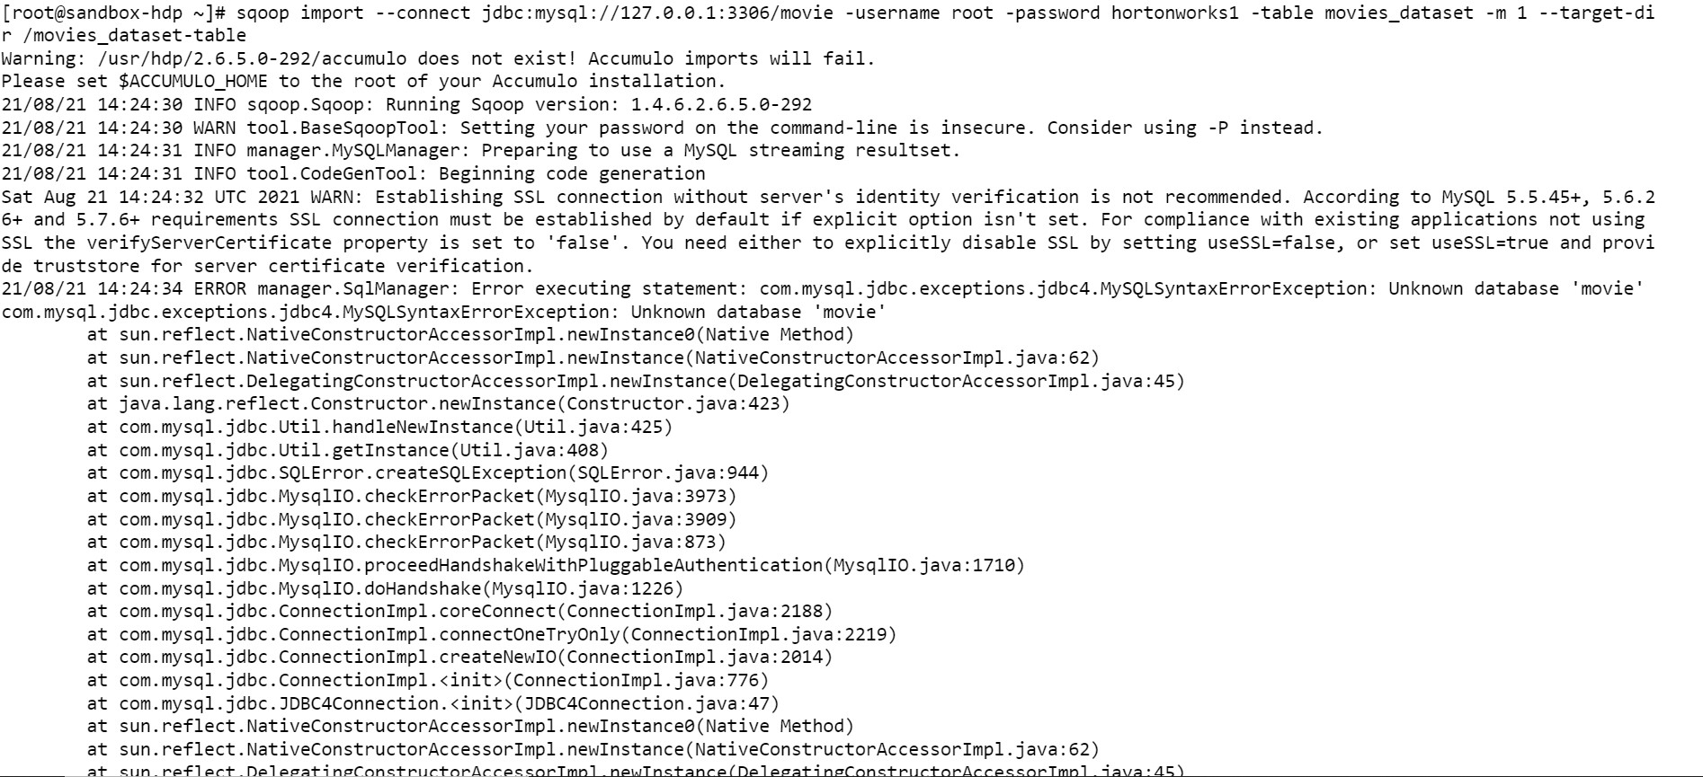
Sqoop commands
# Take data from MySQL DB to your HDFS using Sqoop
Command: sqoop import --connect jdbc:mysql://127.0.0.1:3306/movie -username root -password hortonworks1 -table movies_dataset -m 1 --target-dir /movies_dataset-table

Slide 22
# List the databases
sqoop show-databases --connect jdbc:mysql://127.0.0.1:3306/ --username root --password hortonworks1;
# List the tables in the movie database
sqoop list-tables --connect jdbc:mysql://127.0.0.1:3306/movie --username root --password hortonworks1;
#sqoop eval command
sqoop eval --connect jdbc:mysql://127.0.0.1:3306/movie --username root --password hortonworks1 --query "select * from movies_dataset limit 5;"

Slide 23
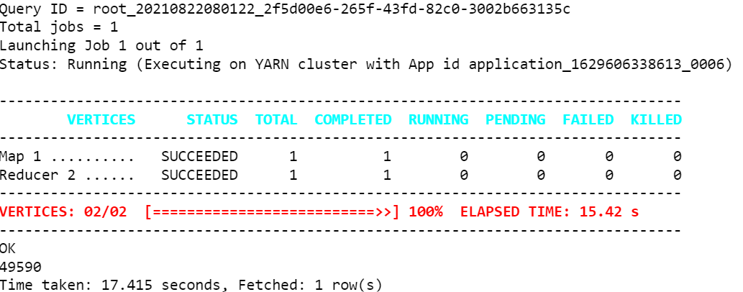

Slide 24
Thank you

